Slide 1
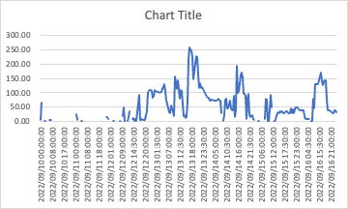
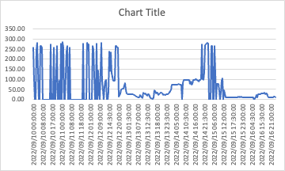
Graph1
Graph2
Both of the above graphs are for the same set of data. Time Interval for the data is 30minutes.
Graph1 is utilization as displayed by default in the report. (i.e. based on an interval of 30 minutes)
Graph2 is based on the “Total Seconds In” (rather than interval).
We can see that the system is pretty heavily used in Graph2 as compared to Graph1.
Customers looking at graph1 may not see the urgency to upgrade bandwidth.

